Slide 1

Introduction to CI/CD pipeline
Eng.Fahd Khaled

Slide 2
What is a CI/CD pipeline?
Continuous integration, delivery and deployment are DevOps practices that aim to speed the software delivery without compromising on quality. By automating as many steps in the process as possible, CI/CD provides rapid feedback builds to shorten the time it takes to release software to users.
Continuous Integration (CI) is a development practice that helps ensure that software components work together. CI allows you to continuously integrate code into a single shared and easy to access repository.
Continuous delivery (CD) is the ability to deploy your integrated code into production without the need of human intervention. CD allows you to take the code stored in the repository and continuously delivery it to production.

Slide 3
Why CI/CD ?
It helps get continuous feedback not only from your customers but also from your own team. Moreover, in an organization, it can also lead to big advantages. Some of the notable benefits of implementing CI/CD pipelines to your everyday software development process..

Slide 4
CI/CD Benefits ?
Reduce costs: Using automation in the CI/CD pipeline helps reduce the number of errors that can take place in the many repetitive steps of CI and CD.
Fault isolations: Designing your system with CI/CD ensures that fault isolations are faster to detect and easier to implement.
Faster release rate: Failures are detected faster and as such, can be repaired faster, leading to increasing release rates.
Smaller code changes: One technical advantage of CI and CD is that it allows you to integrate small pieces of code at one time. This helps developers to recognize a problem before too much work is completed afterward.
More test reliability: Using CI/CD, test reliability improves due to the bite-site and specific changes introduced to the system, allowing for more accurate positive and negative tests to be conducted.

Slide 5
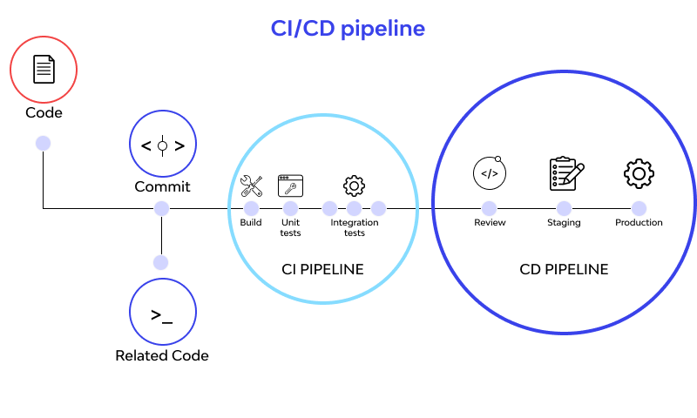
Slide title 29

Slide 6
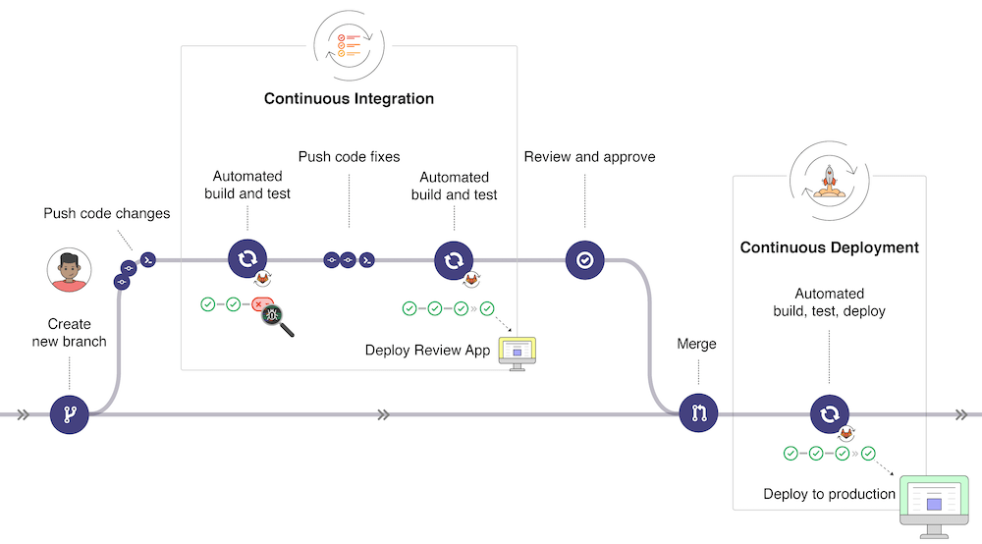
Slide title 29

